Slide 1

Project

Slide 2
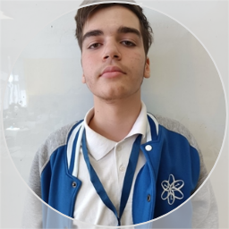
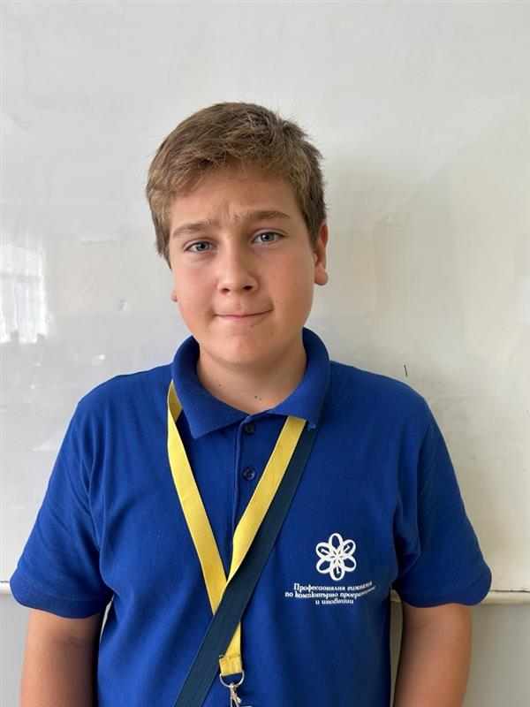
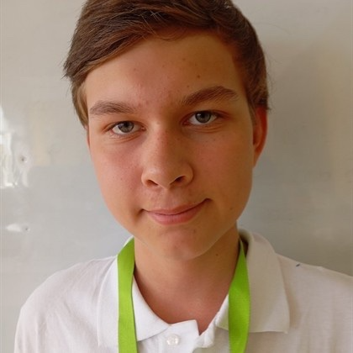
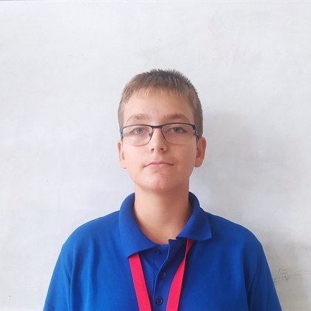
1.People in the team and there specialties
Михаил Мавродиев
Йоан Георгиев
Атрем Бок
Йордан Райнов

Slide 3




2.Apps We used in the project

Slide 4
3.Q&A

Slide 5
Thank you for your attention !

